Slide 1
confusion matrix
And it’s metrics

Slide 2
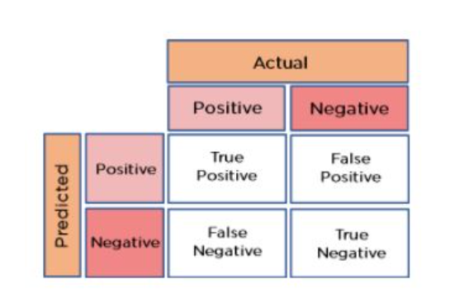
Confusion Matrix
What is Confusion Matrix
“The confusion matrix shows the ways in which your classification model is confused when it makes prediction”
Is a summary of prediction result on a classification problem.
The matrix is divided into two dimensions, that are predicted values and actual values along with the total number of predictions(N).
Predicted values are those values, which are
predicted by the model
Actual values are the true values for the given observations.

Slide 3
To calculate the confusion matrix for a 2-class classification problem, you will need to know the following:
True positives (TP): The number of samples that were correctly predicted as positive.
True negatives (TN): The number of samples that were correctly predicted as negative.
False positives (FP): The number of samples that were incorrectly predicted as positive.
False negatives (FN): The number of samples that were incorrectly predicted as negative.

Slide 4
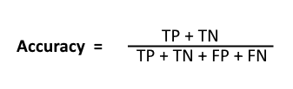



Confusion Matrix Metrics :

Slide 5
Precision: Precision is used to calculate the model's ability to classify positive values correctly. It is the true positives divided by the total number of predicted positive values. Recall: It is used to calculate the model's ability to predict positive values. "How often does the model predict the correct positive values?". It is the true positives divided by the total number of actual positive values.

Slide 6
.
F1-Score: It is the harmonic mean of Recall and Precision. It is useful when you need to take both Precision and Recall into account. accuracy : The accuracy metric computes how many times a model made a correct prediction across the entire dataset

Slide 7
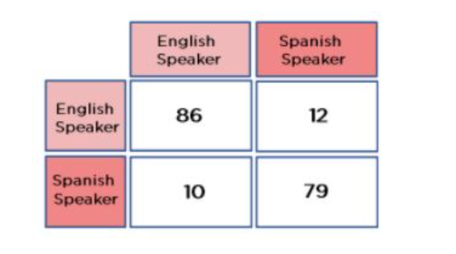
Consider a confusion matrix made for a classifier that classifies people based on whether they speak English or Spanish.
From the above diagram, we can see that:
True Positives (TP) = 86
True Negatives (TN) = 79
False Positives (FP) = 12
False Negatives (FN) = 10

Slide 8
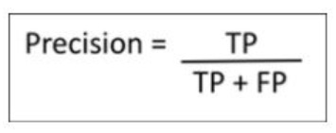
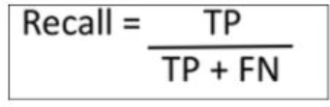
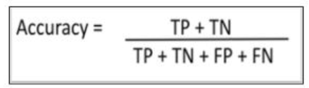
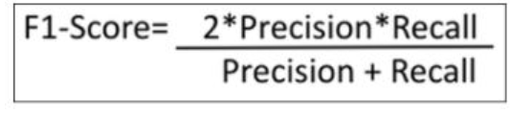
Precision = 86 / (86 + 12) = 0.8775 = 87.75%
Recall = 86 / (86 + 10) = 0.8983 =
89.83%
Accuracy = (86 +79) / (86 + 79 + 12 + 10)= 0.8823 = 88.23%
F1-Score = (2* 0.8775 * 0.8983) / (0.8775 + 0.8983) = 0.8877 = 88.77%

Slide 9
Thank you

